Slide 1
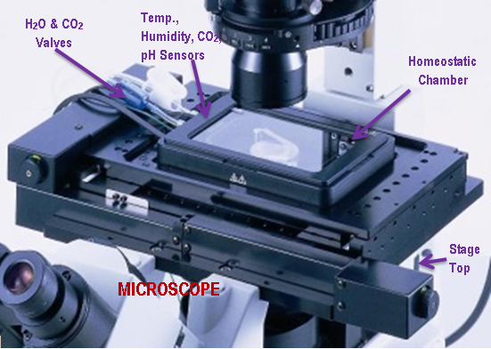
Homeostatic environment chamber
Essential Conditions:
Formulation of Parameters
  CO₂: 5% ± 0.1%
  pH: 7.4% ± 0.04%
  Temperature: 37°C ± 2°C
  Humidity: 95% ± 0.01%
Homeostatic Environment Chamber Placed on Stage Top of Microscope
Source: DSS Imagetech

Slide 2
CONCEPTUAL DESIGN
Homeostatic Environment Chamber
pH Sensor
Humidity Sensor
CO₂ Sensor
Temperature Sensor
Controller

Slide 3
Functional decomposition
Chamber
Sensors
Control System
Source
Display System

Slide 4
Concept generation
Function | Sub-Function
Chamber | Lid CO₂ Valve Water Inlet Insulation | Plexiglass Windows (Top/Bottom) Gasket
Sensors | Temperature CO₂ | pH Humidity
Control System | Temperature Controller CO₂ Controller | Microcontroller Data Collecting Output
Source | Power On/Off | Peltier Coolant
Display System | Temperature CO₂ | pH Humidity

Slide 5
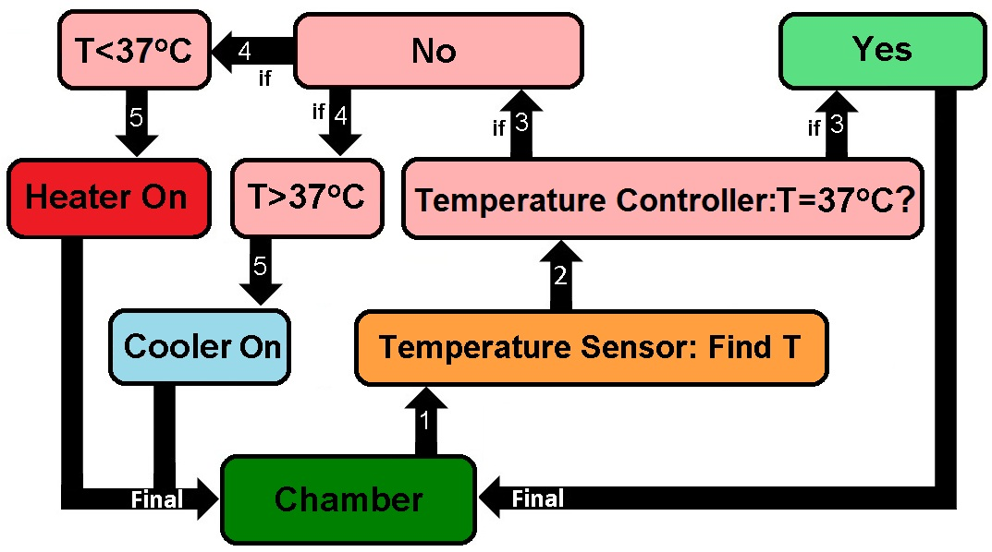
Sub-sub function of controller
Temperature Controller Block Diagram

Slide 6
Design criteria
Sensitivity
Range
Accuracy
Cost
Design Criteria Temperature Sensors
Weighting Matrix | Sensitivity | Range | Accuracy | Cost | Score = Row Sum | Weight.
Sensitivity | X | 5 | 3 | 1 | 9 | 0.25
Range | 1 | X | 1 | 1 | 3 | 0.08
Accuracy | 3 | 5 | X | 3 | 11 | 0.31
Cost | 3 | 5 | 5 | X | 13 | 0.36
Total number of comparisons = Sum of Scores |  |  |  |  | 36 | 1

Slide 7
CONCEPT VARIANTS
Concept Variance Ranking With Respect To Sensitivity
Sensitivity | Thermocouple | RTD | Thermistor | Score = Row Sum | Normal Score
Thermocouple | X | 3 | 1 | 4 | 0.22
RTD | 3 | X | 1 | 4 | 0.22
Thermistor | 5 | 5 | X | 10 | 0.56
Column Sum | 8 | 8 | 2 | 18 | 1
Concept Variance Ranking With Respect To Range
Range | Thermocouple | RTD | Thermistor | Score = Row Sum | Normal Score
Thermocouple | X | 2 | 1 | 3 | 0.17
RTD | 4 | X | 1 | 5 | 0.28
Thermistor | 5 | 5 | X | 10 | 0.56
Column Sum | 9 | 7 | 2 | 18 | 1

Slide 8
Concept variants
Concept Variance With Respect To Accuracy
Accuracy | Thermocouple | RTD | Thermistor | Score = Row Sum | Normal Score
Thermocouple | X | 1 | 3 | 4 | 0.22
RTD | 5 | X | 3 | 8 | 0.44
Thermistor | 3 | 3 | X | 6 | 0.33
Column Sum | 8 | 4 | 6 | 18 | 1
Concept Variance With Respect To Cost
Cost | Thermocouple | RTD | Thermistor | Score = Row Sum | Normal Score
Thermocouple | X | 3 | 3 | 6 | 0.33
RTD | 3 | X | 1 | 4 | 0.22
Thermistor | 3 | 5 | X | 8 | 0.44
Column Sum | 6 | 8 | 4 | 18 | 1

Slide 9
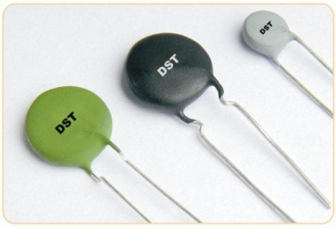
Selection process
Thermistor is the Winner!
-100°C to 150°C
Negative Temperature Coefficient
Highly Sensitive
59¢
Selection Process of Temperature Sensors
 | Sensitivity | Range | Accuracy | Cost | Score
Thermocouple | 0.05 | 0.01 | 0.07 | 0.12 | 0.26
RTD | 0.05 | 0.07 | 0.14 | 0.08 | 0.34
Thermistor | 0.14 | 0.05 | 0.10 | 0.16 | 0.45

Slide 10
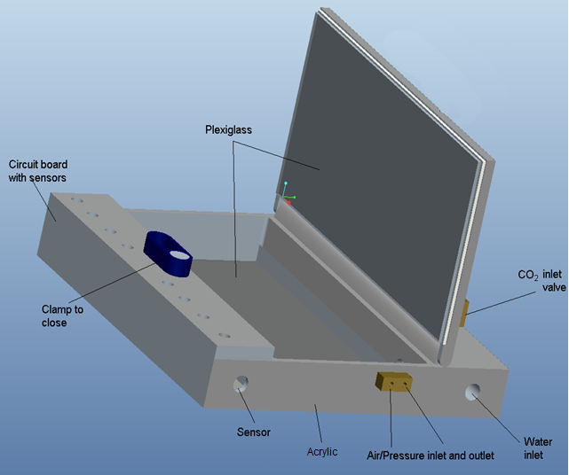
drawings
208mm x 110mm x 25mm

